Slide 1
Embedded Systems Project : AXI4-lite Prof. W. Fornaciari Prof. D. Zoni Tutor: Andrea Galimberti
Group
Colombi Marco
Corbetta Giorgio
Consonni Cesare

Slide 2
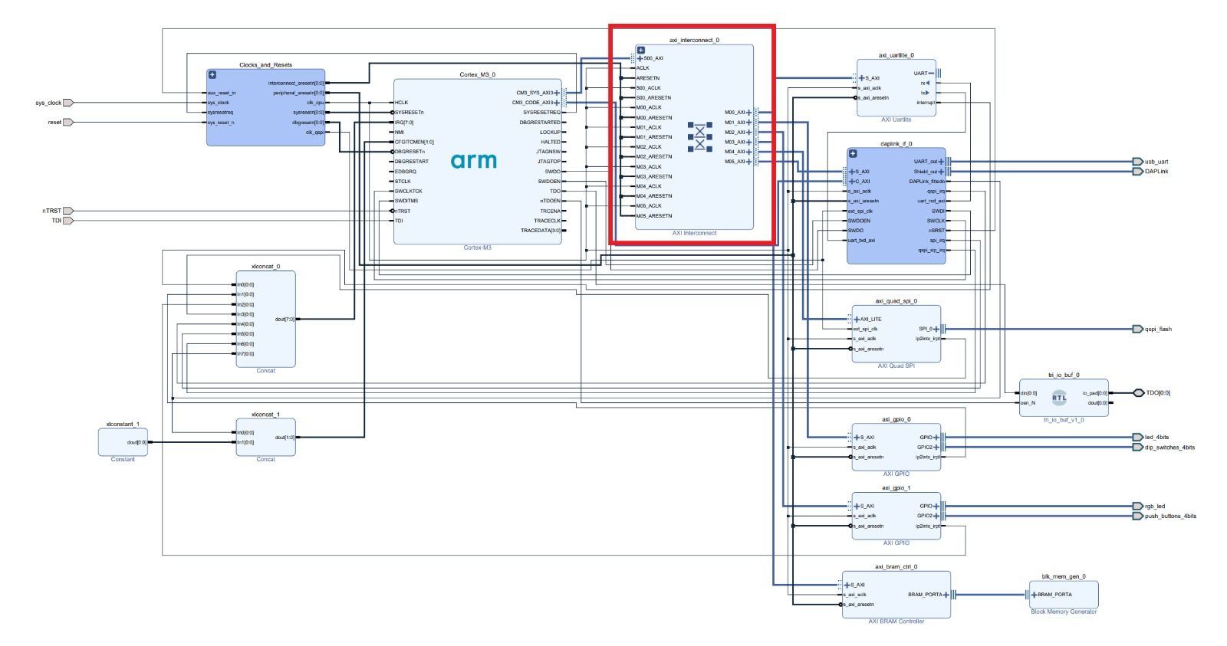

About AXI
AMBA AXI is a parallel communication protocol
multi master
multi slave
High performance
High Frequency
Used (also) inside the processors.
2
Notes:
Course name
Lesson name
© 2000 - Author's name
2

Slide 3
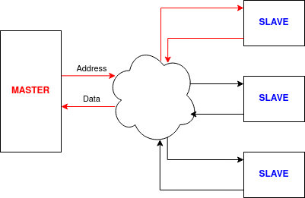
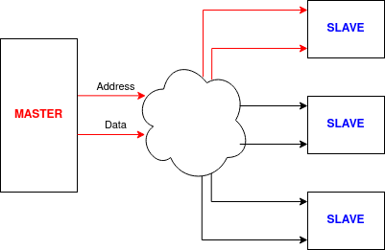
What it does
Two ways to communicate:
Read
Write
AXI has the role to enable such connections
3
Notes:
Course name
Lesson name
© 2000 - Author's name
3

Slide 4
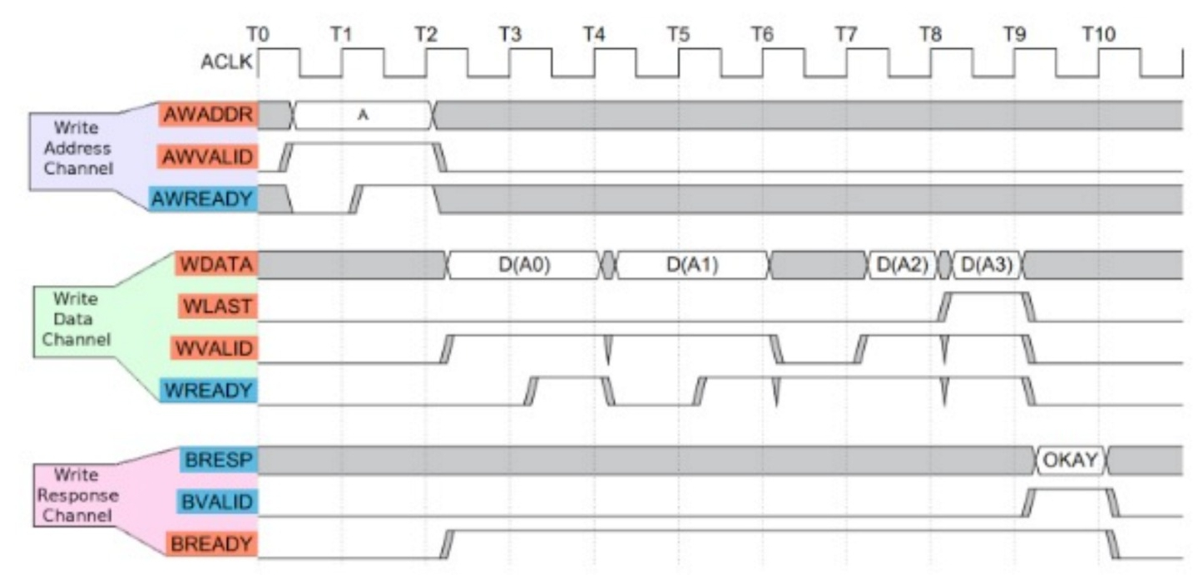
How does it do it
Address mapping
Handshake protocol:
For each line (address, data and BRESP); valid ready resp
4
Notes:
Course name
Lesson name
© 2000 - Author's name
4

Slide 5
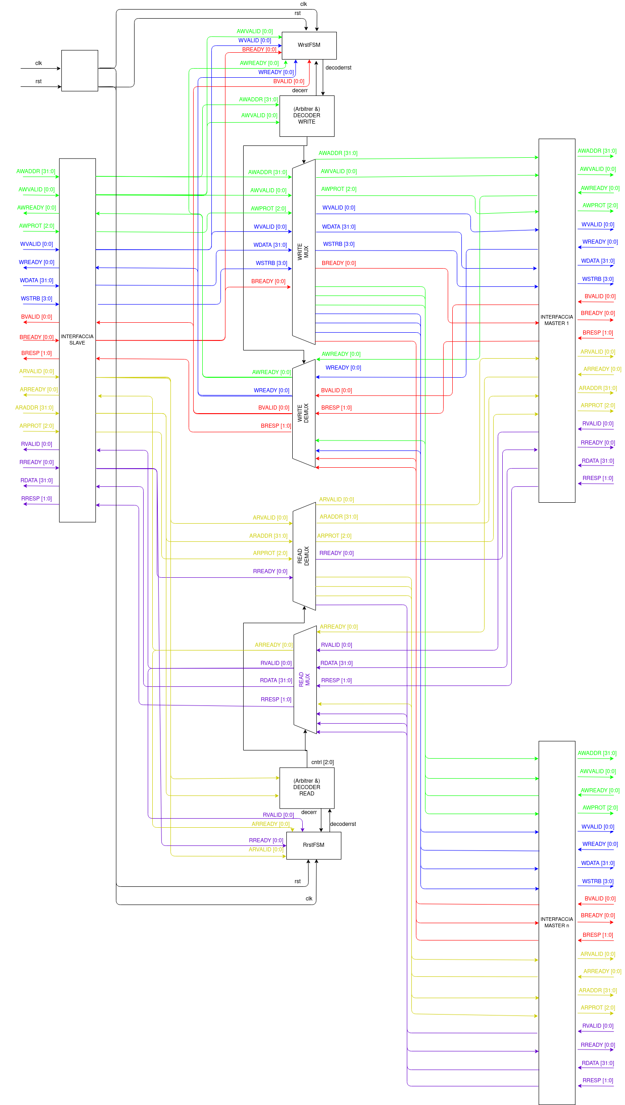
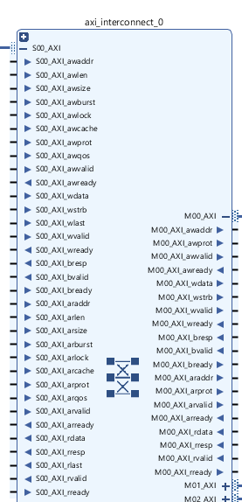
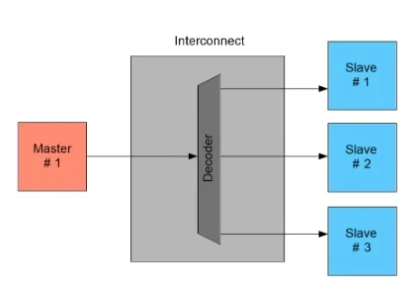
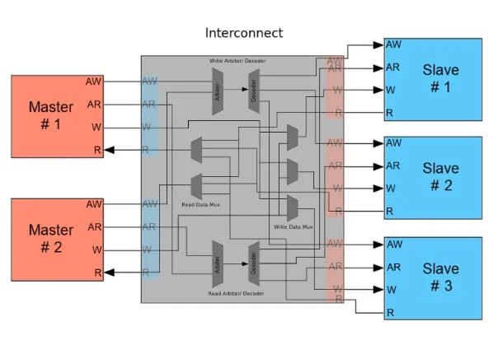
How it’s made
https://www.allaboutcircuits.com
5
Notes:
Course name
Lesson name
© 2000 - Author's name
5

Slide 6
Let’s break the magic
How to connect
Master to Slave
Slave to Master
The MUX and DEMUX need to be driven in some way… How? Let’s go on
DEMUX
MUX
6
Notes:
Course name
Lesson name
© 2000 - Author's name
6

Slide 7


The helm
To who belongs this address to?
DECODER
When is the address valid? When does the connecction end?
FSM
7
Notes:
Course name
Lesson name
© 2000 - Author's name
7

Slide 8
FSM States
ERR STATE
ADDR HS
IDLE
DATA HS
RESET
RESP HS
8
Notes:
Course name
Lesson name
© 2000 - Author's name
8

Slide 9

The Final Recepit
Finally, to build our AXI we used:
1) Big MUXs and DEMUXs
2) Sequential Circuits (decoder’s mapper)
3) FLIP FLOPS (to keep the signal of decoder)
4) FSM
5)Lot of patience 6) Love q.b.
9
Notes:
Course name
Lesson name
© 2000 - Author's name
9

Slide 10

On the AXI
IDLE
RESP HS
ADDR HS
ERR STATE
DATA HS
Standard Case:
Handshake on Address
Handshake on Data
Handshake on Response
Error Case:
Error on the Decoder
Switching to DE/MUX states
Completing the transaction with resp = 111
10
Notes:
Course name
Lesson name
© 2000 - Author's name
10

Slide 11
Difference Between AXI(s)
Features of AXI-Lite:
Burst length = 1
Always use full width of the data bus
All accesses are Normal, Non-modifiable, Non-bufferable
Multi-size registers can be implemented
Need In Order transactions
Do not support Quality of Service
Features of AXI:
Burst transaction (AxLEN, AxBURST, xLAST)
Different width of the data bus (AxSIZE)
Different type of accesses (AxLOCK, AxCACHE)
Multi-size registers can be implemented (xSTRB)
Support Out of Order transactions
Support Quality of Service
11
Notes:
Course name
Lesson name
© 2000 - Author's name
11

Slide 12
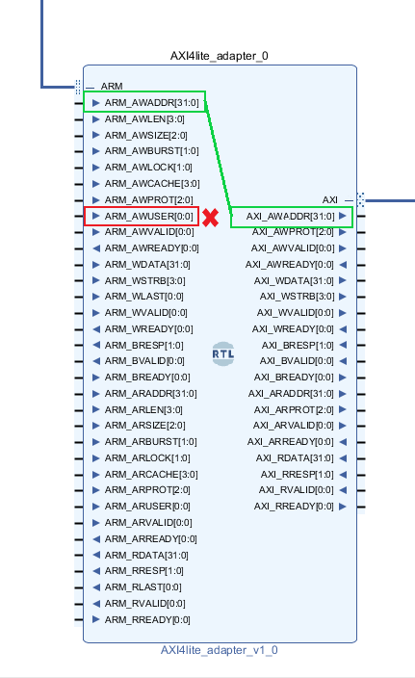

Before connection: protocol adaptation
Simple wire connection for the signals used by both AXI3 and AXI4-lite
Control signals of AXI3 without particular specification, for example:
AxLEN = 0 → no burst lenght
AxSIZE = 2 → data of 32 bit
AxLOCK = 1 → normal access mode
AxUSER = 0 → no usage
Not significant control on RREADY and BREADY

Slide 13
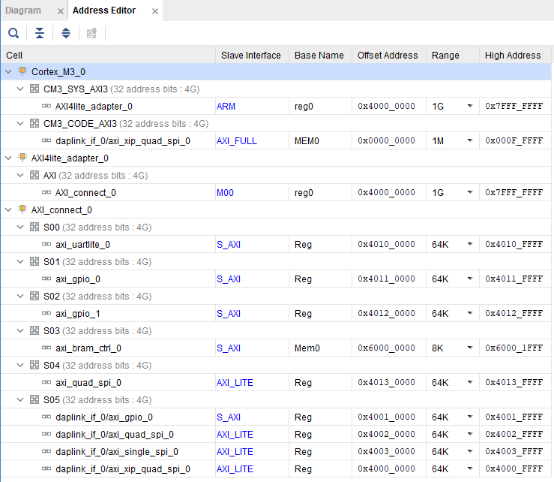
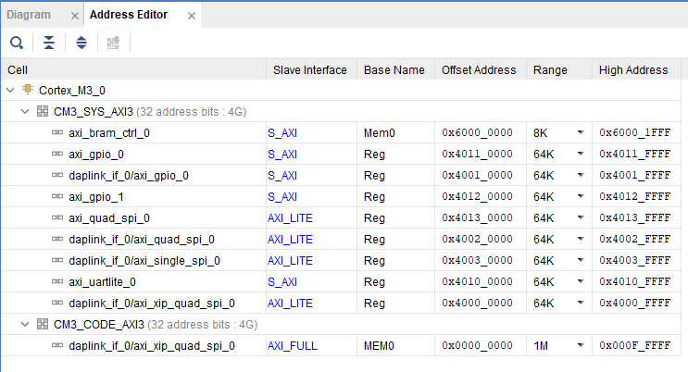
Before connection: mapping addresses
Not only on the decoder but also on the address map

Slide 14
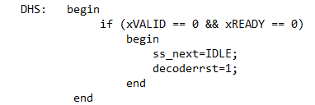
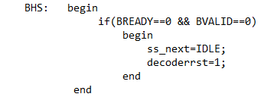
After connection: RREADY and BREADY
RREADY and BREADY always asserted → can’t be used by read and write finite state machine!

Slide 15
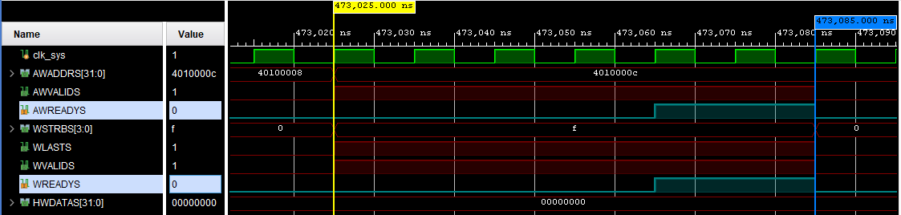
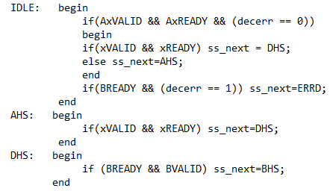
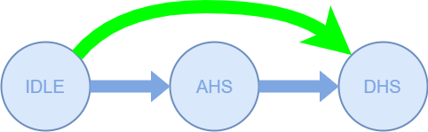
After connection: Write handshake
Slave can answer for both address and data at the same time → AXI can’t stay behind!

Slide 16
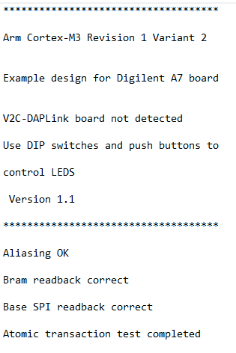
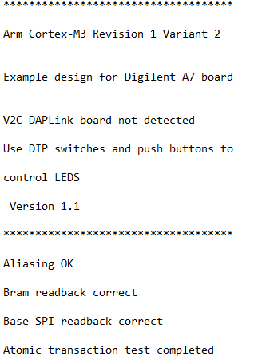
Compare Uart decoding
ARM Design Start
Our AXI

